Slide 1
Combinatorial Benders Approaches to Hard Problems
Michael Trick
Tepper School, Carnegie Mellon
INFORMS/ALIO 2010
Tweet this with
#alioinforms

Slide 2
Outline
Benders Approaches to Optimization
Example 1: Makespan Scheduling
Example 2: Lower Bounds to the Traveling Tournament Problem
Example 3: Shipping Contract Selection
Example 4: The three-phase approach to timetabling
Example 5: Umpire Scheduling (if time)
Why does Benders work? When should you use it?

Slide 3
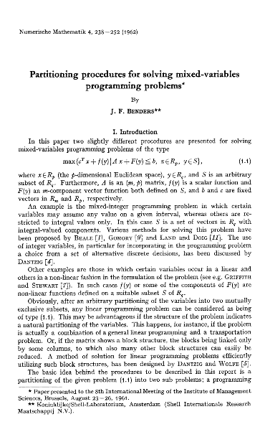
Back to 1962

Slide 4
Benders Approach
Minimize f(x) + cy
Subject to
F(x) + Ay ≥ b
x ∈ S_{x}
y ≥ 0
If the x variables are fixed, then the result is a linear program.
Can we take advantage of this?

Slide 5
Benders Approach: Subproblem
Subproblem relative to solution x^{k} (fixed)
min cy
Ay ≥ b- F(x^{k} )
y ≥ 0
Two possibilities:
Infeasible: proof of infeasibility of x^{k} vector v such that v (b-F(x^{k})) > 0
Feasible: proof of lower bound on optimal objective vector u such that f(x^{k}) + u (b- F(x^{k})) is a lower bound on overall objective.
Key idea: constraints work for all x, not just x^{k} (v and u are feasible for all x)

Slide 6
Benders Approach: Master
Min z
Subject to
x ∈ S_{x}
z ≥ f(x) + u^{k} (b-F(x)) [lower bound constraints]
0 ≥ v^{k} (b-F(x)) [feasibility constraints]
Solve over x

Slide 7
Benders Approach: Iterate
Start with initial test solution: x¹
Solve Subproblem to get
  Infeasibility cut(s)
  Optimality cut(s)
Solve Master problem to get next test solution: x^{k}
Iterate until x^{k} repeats

Slide 8
Generalization: Why did we need linear programming?
Subproblem relative to solution x^{k} (fixed)
min cy
Ay ≥ b- F(x^{k} )
y ≥ 0
Two possibilities:
Infeasible: proof of infeasibility of x^{k} vector v such that v (b-F(x^{k})) > 0
Feasible: proof of lower bound on optimal objective vector u such that f(x) + u (b- F(x)) is a lower bound on overall objective.
Key idea: constraints work for all x, not just x^{k}
Be able to solve subproblem
Find constraint if subproblem is infeasible
Find bound if subproblem is feasible
Must be valid for all x

Slide 9
Combinatorial or Logical Benders
Key idea: Linear programming provides one way to get constraints (through linear programming duality)
Other ways to infer valid feasibility and optimality constraints. Constraints encapsulate the idea:
To get a better (or feasible) x, x must look like this (where this depends on the problem).

Slide 10
Benders Constraints, Examples
1. No Goods
In order to be better than x^{k}, x must be different than x^{k}
Constraint:
x ≠ x^{k}
Simplest (and weakest) constraint possible.
Easy to implement in IP (linear constraint for binary x; easy to add to IP for general x)

Slide 11
Benders Constraints, Examples
2. Infeasibility
If subproblem is infeasible, then determine what makes it so: generate corresponding constraint on x in order to avoid problem.
Possibilities:
  Minimal infeasible subsystems
  Problem specific structures

Slide 12
Benders Constraints Examples
3. Math Programming Duality
As we have seen, if subproblem is a linear program, we get constraints
Can add constraints generated by relaxation of subproblem

Slide 13
Benders Constraints Examples
4. Bounds from inference
Infer (either formally or informally) bounds on the objective from the structure of the solution to the subproblem.

Slide 14
Making it work
To be sure that the approach works, it is necessarily to ensure that you can always generate a constraint whenever x^{k} is not optimal.
Generally a hard thing to do: requires characterization of y subproblem
Sometimes easy:
  Linear programming subproblem
But no-goods provide “constraint of last resort”

Slide 15
Generic Subproblem solver
Try Constraint type 1
Found?
Don’t need
Full characterization!
Yes
No
Try Constraint type 2
Found?
Yes
No
Generate no-good

Slide 16
No goods
Easy if master problem is binary integer program. To implement x ≠ xk for x=(x1,x2,…xn) then add constraint
  ∑_{{i : xi}k _{= 1}} x_{i} + ∑_{{i: xi}k _{= 0}} (1-x_{i}) ≤ n-1

Slide 17
General Integer Programming
Can’t be formulated in integer programming but easy to implement.
Simply track no-goods in search tree and mark nodes infeasible if match to no-good.
No-good not part of linear relaxation, but easily implemented through node call-back routines
Summary: tell code to keep going if hit a no-good

Slide 18
Examples
Limit ourselves to master problem is integer program (generally binary)
Constraints typically are not complete: we need to resort to no-goods

Slide 19
Example 1: Machine Scheduling
(Hooker 2000, Jain & Grossmann 2001)
Multiple jobs, multiple machines
x variables: x[i,j] is 1 if machine job i is placed on machine j
y variables: y[i] is the start time for job i
Each job has a release time, deadline, and processing time
Goal is to minimize makespan
Master Problem
Minimize v
Subject to
Every job on a machine
v >= processing time assigned to each machine
(This ignores release and deadlines)

Slide 20
Machine scheduling subproblem
Subproblems: Series of one machine problems to get s[i]
Minimize makespan
Subject to
Release times
Due dates
Disjunction (one job on machine at time)
Solve by your favorite approach (probably CP or specialized branch and bound)
If infeasible, generate constraint that not all of the jobs can go on that machine

Slide 21
Machine Scheduling Subproblem
If feasible, with makespan m, find set of jobs that force makespan m
A
B
D
E
r[A],r[B],r[D]
m
v >= m(x[A,j]+x[B,j]+x[C,j]-2)

Slide 22
Benders Constraint
This is an example (one of few) where the subproblem generates more than infeasibility Benders constraints
Not based on linear programming duality, but on a form of inference duality.

Slide 23
Example 2: Traveling Tournament Problem
Given an n by n distance matrix D= [d(i,j)] and an integer k find a double round robin (every team plays at every other team) schedule such that:
  The total distance traveled by the teams is minimized (teams are assumed to start at home and must return home at the end of the tournament), and
  No team is away more than k consecutive games, or home more than k consecutive games.
  (For the instances that follow, an additional constraint that if i is at j in slot t, then j is not at i in t+1.)

Slide 24
Sample Instance
NL6: Six teams from the National League of (American) Major League Baseball. Distances:
0 745 665 929 605 521
745 0 80 337 1090 315
665 80 0 380 1020 257
929 337 380 0 1380 408
605 1090 1020 1380 0 1010
521 315 257 408 1010 0
k is 3

Slide 25
Sample Solution
Distance: 23916 (Easton May 7, 1999)
Slot ATL NYM PHI MON FLA PIT
0 FLA @PIT @MON PHI @ATL NYM
1 NYM @ATL FLA @PIT @PHI MON
2 PIT @FLA MON @PHI NYM @ATL
3 @PHI MON ATL @NYM PIT @FLA
4 @MON FLA @PIT ATL @NYM PHI
5 @PIT @PHI NYM FLA @MON ATL
6 PHI @MON @ATL NYM @PIT FLA
7 MON PIT @FLA @ATL PHI @NYM
8 @NYM ATL PIT @FLA MON @PHI
9 @FLA PHI @NYM PIT ATL @MON

Slide 26
Simple Problem, yes?
NL12. 12 teams
Feasible Solution: 143655 (Rottembourg and Laburthe May 2001), 138850 (Larichi, Lapierre, and Laporte July 8 2002), 125803 (Cardemil, July 2 2002), 119990 (Dorrepaal July 16, 2002), 119012 (Zhang, August 19 2002), 118955 (Cardemil, November 1 2002), 114153 (Van Hentenryck January 14, 2003), 113090 (Van Hentenryck February 26, 2003), 112800 (Van Hentenryck June 26, 2003), 112684 (Langford February 16, 2004), 112549 (Langford February 27, 2004), 112298 (Langford March 12, 2004), 111248 (Van Hentenryck May 13, 2004), 110729 (Van Hentenryck and Vergados, May 30 2007).
Lower Bound: 107483 (Waalewign August 2001), 107494 (Melo, Ribeiro, and Urrutia July 15 2006)
Can we improve this via Benders?

Slide 27
Formulation for Benders
Key is to formulate in terms of x and y such that
  Solving for y is “easy” for each x
  Master problem (in terms of x) is relatively easy, and
  Good Benders’ cuts link them
  (In this example, the Benders will simply be no-goods)

Slide 28
Formulation
Let x[i,S] be 1 if team i visits cities S consecutively, where S is an ordered sequence
Let y[i,S,t] be 1 if team i visits cities S consecutively (S an ordered sequence), starting in time slot t

Slide 29
Illustratrative Solutions
SUBPROBLEM
MASTER
Team 2
0 H
H
1
4
5
H
H
H
12
10
8
H
H
13 H
14 9
15 11
16 H
17 H
18 H
19 7
20 6
21 3
22 H
1 4 5
3 6 7
8 10 12
9 11

Slide 30
Constraints
Master: Break down by Team
  Visit every Team
  No more than 3 in sequence
  Cost based on travel of sequences
Subproblem: Link teams
  Use only sequences from Master
  If team i plays at j in slot t, then j home in slot t
  No more than one team at j in any slot
  No consecutive away; no more than k consecutive home

Slide 31
Traveling Tournament Problem
Solve individual teams problems to get best sequences (trips)
Determine if trips fit together. If so, then optimal, else
Generate “no-good” and find next best combination of sequences

Slide 32
Results
1 | 8282 | 8297 | 8354 | 8362 | 8398
2 | 8935 | 8944 | 8956 | 8972 | 8981
3 | 8554 | 8563 | 8571 | 8596 | 8625
4 | 9330 | 9355 | 9366 | 9375 | 9393
5 | 11184 | 11194 | 11209 | 11214 | 11219
6 | 7627 | 7636 | 7661 | 7692 | 7701
7 | 7319 | 7392 | 7397 | 7417 | 7426
8 | 7733 | 7744 | 7782 | 7806 | 7822
9 | 7986 | 8027 | 8065 | 8068 | 8075
10 | 8033 | 8120 | 8140 | 8144 | 8153
11 | 10739 | 10742 | 10816 | 10819 | 10837
12 | 11761 | 11777 | 11845 | 11864 | 11872
For 12 teams, the best trips for each team can be generated in a matter of seconds
Easy to generate sets in order of size

Slide 33
Start solving subproblems
Take best combination, and solve subproblem (again, a few seconds to prove infeasibility)
Generate next best combination, and repeat.
Infeasibility generates lower bound
Benders constraints in Master problem: just no-goods:
∑_{{i : xi}k _{= 1}} x_{i} ≤ 11

Slide 34
Updated results
NL12. 12 teams
Feasible Solution: 143655 (Rottembourg and Laburthe May 2001), 138850 (Larichi, Lapierre, and Laporte July 8 2002), 125803 (Cardemil, July 2 2002), 119990 (Dorrepaal July 16, 2002), 119012 (Zhang, August 19 2002), 118955 (Cardemil, November 1 2002), 114153 (Van Hentenryck January 14, 2003), 113090 (Van Hentenryck February 26, 2003), 112800 (Van Hentenryck June 26, 2003), 112684 (Langford February 16, 2004), 112549 (Langford February 27, 2004), 112298 (Langford March 12, 2004), 111248 (Van Hentenryck May 13, 2004), 110729 (Van Hentenryck and Vergados, May 30 2007).
Lower Bound: 107483 (Waalewign August 2001), 107494 (Melo, Ribeiro, and Urrutia July 15 2006) , 107548 (Mitchell, Trick and Waterer July 31 2008)

Slide 35
Example 1
Even a very simple implementation can improve on alternative approaches
Key here was formulating so that simple Benders could work

Slide 36
Example 3. Transportation Contracting
Trucking example
  want to choose cheapest fleet of trucks to meet shipping needs
Data
  Shipments to be made
    size, time must leave by
  Available trucks
    size (capacity), time truck leaves, cost
  Previous work (with Pajunas, Matto, and Zuluaga): integer program can solve provided redundant constraints added to add knapsack constraints

Slide 37
Network Problem
Pickup
B→E
Deliver
E
B
D
A→D
A
F
C
A→F
C→E
C→F
Volume
V1
V2
V3
V4
V5
Deliveries
Possible
Routes
Capacity
S1
S2
S3
Cost
C1
C2
C3
A→D
A→F
B→E
C→E
C→F

Slide 38
Network Problem

Slide 39
Nicely set up for Benders!
Master problem: choose contracts
Subproblem: assign packages to chosen contracts

Slide 40
Network Benders Cuts
Weak Delivery Set Cuts:
  These are classical
  Benders cuts
1
1
2
Deliveries
2
3
Routes
3
4
4
5
6
5
7
Adding this constraint for all deliveries was critical in original paper

Slide 41
Network Benders Cuts
Strong Delivery Set Cuts:
  These are logical Benders cuts

Slide 42
Network Benders Cuts
Weak vs. Strong Delivery Set Cuts
Deliveries
(unsplittable)
V1=3
V2=4
V3=4
S1=6
S2=5
S3=12
1
1
Routes
2
2
3
3

Slide 43
Other cuts
Other heuristics are used to find and strengthen capacity cuts (6 in total).
If no cut found, then use “no-good” on the x variables.

Slide 44
Experiment
Setup 1: Geographical
Deliver
Pickup

Slide 45
Experiment
Setup 2: Random

Slide 46
Experiment
Setup 3: Timeline
A
B
6 AM
9 AM
12 PM
3 PM
6 PM

Slide 47
Experiment
Focus on delivery sets contained in some interval.
The number of interval sets is compared to sets total.
6 AM
9 AM
12 PM
3 PM
6 PM
Interval

Slide 48
Experiment Results: Geographical Setup
Setup | % Integer | # Dels per Route | Problem Size (Routes, Dels) | Std CPLEX Runtime | Benders Runtime | Ratio (Full/Benders) | Mas ter | Enum | Opt Vol | Opt Gen | Quit
Geo | 0% | 5 | (1200,300) | 9349 s | 184 s | 0.020 | 51% | 47% | 2% | 0% | 0%
Geo | 0% | 10 | (2100,500) | 14749 s | 26740 s | 1.813 | 51% | 49% | 0% | 0% | 0%
Geo | 0% | 20 | (6000,1200) | 620 s | 3 s | 0.005 | 42% | 28% | 7% | 0% | 0%
Geo | 0% | 40 | (3600,800) | 13888 s | 29 s | 0.002 | 96% | 2% | 0% | 0% | 0%
Geo | 50% | 5 | (1200,300) | 4224 s | 889 s | 0.210 | 80% | 4% | 5% | 0% | 10%
Geo | 50% | 10 | (2100,500) | 2064 s | 4722 s | 2.288 | 30% | 0% | 16% | 1% | 54%
Geo | 50% | 20 | (2100,500) | 1679 s | 30 s | 0.018 | 61% | 0% | 36% | 1% | 0%
Geo | 50% | 40 | (3600,800) | 484 s | 7 s | 0.015 | 51% | 0% | 31% | 0% | 0%
Geo | 100% | 5 | (2100,500) | 8507 s | >30000 s | >5 | 4% | 0% | 96% | 0% | 0%
Geo | 100% | 10 | (1200,300) | 255 s | 1001 s | 3.928 | 14% | 6% | 1% | 38% | 41%
Geo | 100% | 20 | (3600,800) | 534 s | 11 s | 0.021 | 40% | 28% | 0% | 0% | 0%
Geo | 100% | 40 | (2100,500) | 2527 s | 31 s | 0.012 | 60% | 29% | 0% | 0% | 0%

Slide 49
Experiment Results: Random Setup
Setup | % Integer | # Dels per Route | Problem Size (Routes, Dels) | Std CPLEX Runtime | Benders Runtime | Ratio (Full/Benders) | Mas ter | Enum | Opt Vol | Opt Gen | Quit
Rand | 0% | 5 | (200,70) | 273 | 17818 s | 65.348 | 70% | 29% | 0% | 0% | 0%
Rand | 0% | 10 | (200,70) | 187 | 79 s | 0.421 | 55% | 44% | 1% | 0% | 0%
Rand | 0% | 20 | (200,70) | 387 | 19 s | 0.049 | 97% | 3% | 0% | 0% | 0%
Rand | 0% | 40 | (300,100) | 4782 | 47 s | 0.010 | 95% | 4% | 0% | 0% | 0%
Rand | 50% | 5 | (200,70) | 606 | 10145 s | 16.745 | 98% | 2% | 0% | 0% | 0%
Rand | 50% | 10 | (200,70) | 612 | 152 s | 0.248 | 73% | 25% | 0% | 2% | 0%
Rand | 50% | 20 | (200,70) | 309 | 10 s | 0.031 | 97% | 2% | 0% | 0% | 0%
Rand | 50% | 40 | (300,100) | 15285 | 46 s | 0.003 | 95% | 4% | 0% | 0% | 0%
Rand | 100% | 5 | (300,100) | 290 | >30000 s | >103 | 88% | 12% | 0% | 0% | 0%
Rand | 100% | 10 | (200,70) | 1736 | 801 s | 0.461 | 79% | 2% | 0% | 19% | 0%
Rand | 100% | 20 | (200,70) | 872 | 42 s | 0.048 | 92% | 1% | 0% | 0% | 0%
Rand | 100% | 40 | (300,100) | 7472 | 24 s | 0.003 | 82% | 4% | 0% | 0% | 0%

Slide 50
Experiment Results: Timeline Setup
Setup | % Integer | # Dels per Route | Problem Size (Routes, Dels) | Std CPLEX Runtime | Benders Runtime | Ratio (Full/Benders) | Mas ter | Enum | Opt Vol | Opt Gen | Quit
Time | 0% | 5 | (300,100) | 2441 s | 5698 s | 2.335 | 97% | 0% | 3% | 0% | 0%
Time | 0% | 10 | (300,100) | 199 s | 14 s | 0.071 | 64% | 1% | 32% | 0% | 0%
Time | 0% | 20 | (300,100) | 125 s | 4 s | 0.030 | 51% | 4% | 37% | 0% | 0%
Time | 0% | 40 | (300,100) | 226 s | 1 s | 0.004 | 30% | 50% | 0% | 0% | 0%
Time | 50% | 5 | (200,70) | 4639 s | 1284 s | 0.277 | 6% | 0% | 1% | 0% | 93%
Time | 50% | 10 | (300,100) | 528 s | 174 s | 0.330 | 8% | 0% | 3% | 2% | 87%
Time | 50% | 20 | (450,140) | 6663 s | 97 s | 0.015 | 90% | 1% | 8% | 0% | 0%
Time | 50% | 40 | (300,100) | 256 s | 1 s | 0.002 | 5% | 51% | 10% | 0% | 0%
Time | 100% | 5 | (300,100) | 173 s | >30000 s | >174 | 95% | 0% | 5% | 0% | 0%
Time | 100% | 10 | (100,40) | 1185 s | 778 s | 0.657 | 0% | 0% | 0% | 88% | 12%
Time | 100% | 20 | (200,70) | 4262 s | 260 s | 0.061 | 0% | 0% | 7% | 20% | 0%
Time | 100% | 40 | (200,70) | 430 s | 3 s | 0.007 | 1% | 0% | 0% | 0% | 0%

Slide 51
Example 2. Why?
Why does Benders work here?
  Smaller problems to solve. Full problem has #contracts times #deliveries variables; Benders Master has #contracts variables; subproblem has #deliveries times #accepted contracts: much smaller when the average number of deliveries/truck is high.
  Good cuts. Original work added cut for overall capacity; these are generalizations of those cuts
  Little need for “no-goods”; cuts almost always found without resorting to no-goods

Slide 52
Example 4: Improved 3 phase approach to sports scheduling (with R. Rasmussen)
3 Phase approach to sports scheduling
Most common method in literature
Began for me with Atlantic Coast Basketball Scheduling

Slide 53
Atlantic Coast Conference
Nine teams in southeastern US
  Highest revenue sport: $33 million/year in TV revenue alone
  Perennial powerhouse: three national championships in the 90s alone
  Extensive national TV contracts with ESPN, ABC, CBS, and Raycom

Slide 54
Description of Schedule
Home and home schedule (16 games each: 8 home and 8 away)
Schedule length: 9 weeks
Each team plays twice a week with two “byes”
Many schedule restrictions, preferences, concerns

Slide 55
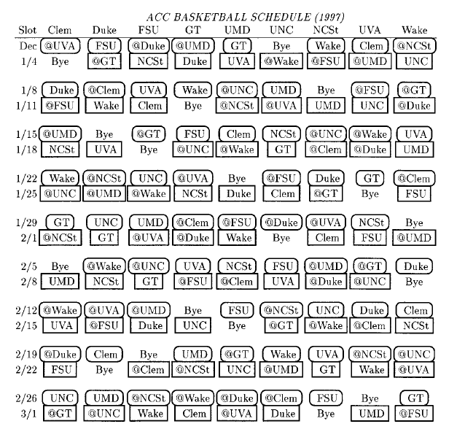
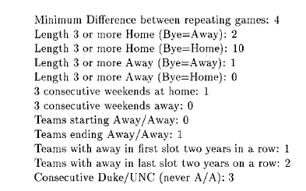

Slide 56
Goals
Due to
  1996-1997 schedule unsatisfactory
  Increasing demands from TV/teams
  Frustration with hand-creation of schedules
Can we create a system that can quickly/ easily handle constraints/ objectives to find reasonable schedules?

Slide 57
Requirements
Lots of requirements on patterns
Each week as a “During Week” game and a “Weekend” game
4 home weekends, 4 away weekends, one by weekend
No AAA or HHH sequences
Do not end AA
Many team requests, including required byes, need to open/finish at home
Finish season with “traditional rivals”
TV preferences. Very convoluted
Two Duke/UNC games in second half
No Duke/UNC or Duke/Wake/UNC (any order) sequences

Slide 58
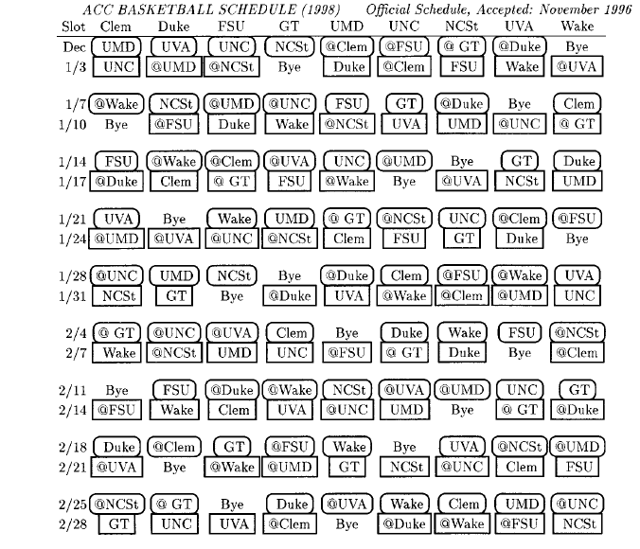
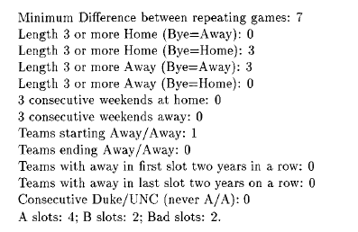

Slide 59
Technique developed
Three phases:
Find H/A patterns (IP)
Assign games to H/A patterns (IP)
Assign teams to H/A patterns (enumerate)
(details in Operations Research paper)

Slide 60
Phase 1: Find HAPs
Find Home/Away pattern, one sequence per team
1: HAHAH
2: AHAHA
3: HHAAH
4: HAHHA
5: AAHHA
6: AHAAH

Slide 61
Phase 2. Assign Games
Assign games consistent with HAP (+ denotes home; - is away)
1: +2 -3 +6 -4 +5
2: -1 +4 -5 +6 -3
3: +6 +1 -4 -5 +2
4: +5 -2 +3 +1 -6
5: -4 -6 +2 +3 -1
6: -3 +5 -1 -2 +4

Slide 62
Phase 3. Assign Teams
Assign teams to entries
F: +E -A +B -D +C
E: -F +D -C +B -A
A: +B +F -D -C +E
D: +C -E +A +F -B
C: -D -B +E +A -F
B: -A +C -F -E +D

Slide 63
How did we do each step?
(pattern sets) Enumeration and integer programming (38 patterns lead to 17 pattern sets)
(timetables) Integer programming give 826 timetables
(schedules) Enumeration of 299,738,880 possibilities gives 17 schedules, from which one was chosen.
Henz improved on this with constraint programming

Slide 64
Thinking in the Benders Way
Rather than generating all timetables, we can generate them one-by-one. Given a timetable, we can then try to assign teams to patterns. If we can do so, then we have a feasible schedule.
If not, then we can identify structures so that we don’t generate “impossible” timetables

Slide 65
Context (since ACC too easy)
Rather than work with a particular league, we work on finding double round robin tournaments that
  Minimize consecutive AA or HH
  Satisfy place constraints (series of constraints that state that team i is home (or away) in slot t)
  Satisfy separation constraints on time between A at B and B at A for all A and B.
Same three phase approach

Slide 66
Pattern selection
Given a set of patterns, find a pattern set
Each pattern i has b[i] breaks; h[i,t]=1 if pattern i is home in time t
Variable x[i] = 1 if pattern set i chosen
Minimize Σ b[i]x[i]
Subject to
Σ h[i,t]x[t] = n/2 for all t
(half teams at home)
x[i] binary
1: HAHAH
2: AHAHA
3: HHAAH
4: HAHHA
5: AAHHA
6: AHAAH

Slide 67
What can go wrong?
Resulting pattern set might not have a feasible timetable (half at home is necessary, but not sufficient)
Might not be able to assign teams to patterns due to place constraints
Each can generate Benders constraints

Slide 68
Assigning teams to patterns
Set feasible but not proven optimal
Set not found
Add cut
Set infeasible
Generate patterns
Find a pattern set
Check feasibility
Assign games & allocate teams
Patterns not found
Patterns found
Set found
Set not proven infeasible
Set feasible and optimal
Stop
Stop
Feasibility check and cuts (Team allocation)
  Due to place constraints all teams might not be able to use all patterns
  The allocation corresponds to a matching in a bipartite graph
Use the Hungarian Method to:
- Find a set of teams which cannot be assigned to the pattern set or
- Find a feasible matching
Teams
Patterns
1
1
2
2
3
3
4
4

Slide 69
Assigning teams to patterns
Set feasible but not proven optimal
Set not found
Add cut
Set infeasible
Generate patterns
Find a pattern set
Check feasibility
Assign games & allocate teams
Patterns not found
Patterns found
Set found
Set not proven infeasible
Set feasible and optimal
Stop
Stop
Feasibility check and cuts (Team allocation)
  Due to place constraints all teams might not be able to use all patterns
  The allocation corresponds to a matching in a bipartite graph
Use the Hungarian Method to:
- Find a set of teams which cannot be assigned to the pattern set or
- Find a feasible matching
If no matching exists:
- Add a cut to the master problem (need at least 3 patterns suitable for 1,2, 4 in this case)
Teams
Patterns
1
1
2
2
3
3
4
4

Slide 70
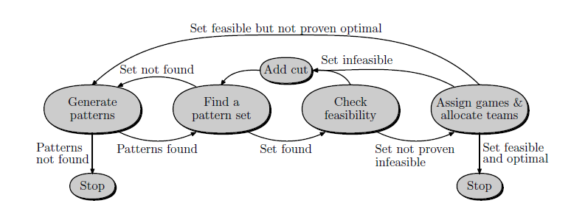
Other Benders constraints
Lots of other structures to use.
  Diversity of Patterns (Miyashu et al. constraint)
  Game separation
  Game assignment
Don’t need to find complete set: can always add “no-good”

Slide 71
Solution Method
Computation time
  When formulated as an IP problem it takes:
    > 10 minutes for: mirrored 14 teams
    > 10 minutes for: non-mirrored 12 teams (k = 0)
    4979 sec for: non-mirrored 8 teams (k = 1)
  Pure CP results worse (not using Henz’ matching constraint)!
  With PGBA:
    0.19 sec for: mirrored 14 teams
    1.41 sec for: non-mirrored 12 teams (k = 0)
    0.56 sec for: non-mirrored 8 teams (k = 1)

Slide 73
Summary of Example 4
Can add stronger constraints than “no-goods” (which was essentially the approach of Nemhauser/Trick and Henz) to get much faster method

Slide 74
Final Example: Scheduling Umpires
Here we use benders’ cuts to guide a greedy heuristic.

Slide 75
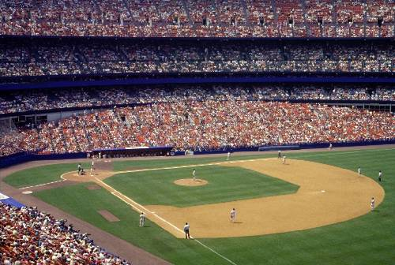
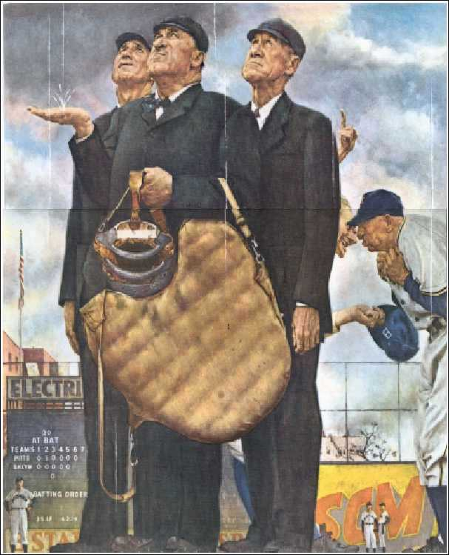
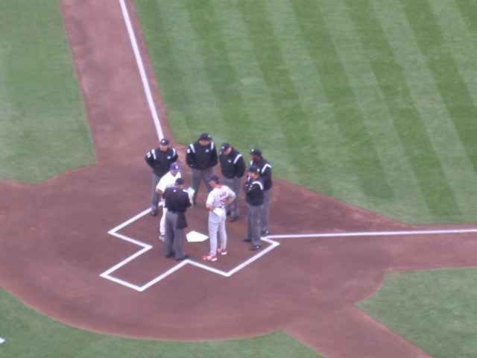
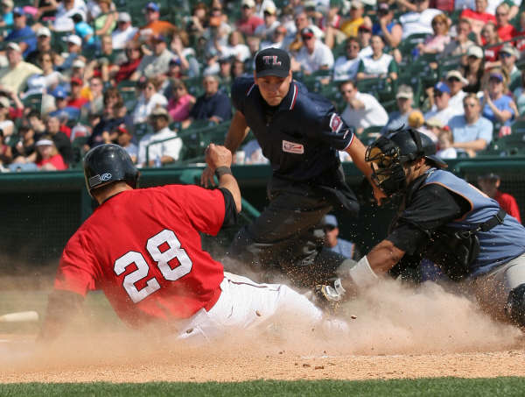
Umpires
Christy Mathewson:
Many fans look upon the umpire as sort of a necessary evil to the luxury of baseball, like the odor that follows an automobile.

Slide 76
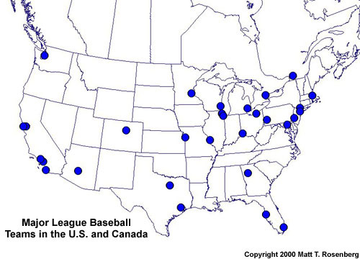

Slide 77
Traveling Umpire Problem
Goal: Create a problem that includes all the critical features of the problem, but no extraneous stuff
Example: Traveling Tournament Problem (TTP) abstracts out the team schedule aspects for MLB
  http://mat.tepper.cmu.edu/TOURN

Slide 78
Formal Description
Double round robin tournament with home/aways assigned
2n teams
4n-2 slots
n umpires
Flexibility parameters d₁ and d₂ >=0.
Goal: assign one of n umpires to each game to minimize total umpire travel
Notes:
Formally, we have 2n teams and we are given a double round robin tournament, where every team plays against all other teams twice. This means we have 4n-2 time slots and we want to assign one of n umpires to each game to minimize total umpire travel.

Slide 79
Problem Description: Constraints
Every game gets an umpire
Every umpire works exactly one game per slot
Every umpire sees every team at least once at the team's home
No umpire is in a home site more than once in any (n - d₁) consecutive slots
No umpire sees a team more than once in any n/2- d₂ consecutive slots
  (easy to show if d₁ or d₂ < 0, then can be infeasible)
Notes:
And we want to satisfy the following set of constraints.
We have three type of constraints :
The parameters in C4 and 5 are not chosen arbitrarily. We show in our working paper that n and n/2 are upper bounds for feasibility when the constraints are applied individually. When we require both of them at the same time, the problem becomes infeasible for some instances.

Slide 80
4 Team Example
n - d₁ = 2; n/2- d₂ = 1
(home team, away team)
Notes:
In Slot 1, the games are (1,3) and (2,4). We arbitrarily assign them to the umpires.

Slide 81
Suitability as a problem
Well defined
Abstracts key issue of travel versus need to see all teams
Reasonably compact data requirements
Straightforward integer and constraint programming formulations

Slide 82
IP and CP results d₁ = d₂ = 0
 |  | Time(sec)
# of Teams | Total Distance | IP | CP
4 | 5176 | 0.07 | 0.02
6 | 14077 | 0.27 | 1.35
8 | 34311 | 1.6 | 869.39
10 | 48942 | 47333.7 | -
Notes:
The results for the IP and CP for the smaller instances at $d_{1} = d_{2}=0.$ are as follows. The IP can solve the 10 team instance to optimality in more than 13 hours, whereas CP was unable to solve that instance. We present these results to demonstrate that the problem becomes very difficult to solve as we increase the number of teams.

Slide 83
Greedy Matching Heuristic
For every slot t
  Assign umpires to games such that
    Constraints are satisfied
    Total travel cost at Slot t is minimized
Perfect Matching Problem on a Bipartite Graph:
  Partitions: Umpires--Games in slot t
  Edges: (u,(i,j)) exist if constraints 4&5 are not violated by assigning u to game (i,j) in slot t.
  Cost of edge (u,(i,j)) = distance(k,i), where k is the venue that u is assigned in slot t-1
Notes:
Greedy Matching Heuristic is a constructive heuristic, which builds the umpire schedules starting from Slot 1 and ending at Slot $4n-2$. For every slot $t$, the heuristic assigns umpires to games such that all constraints, except Constraint 3, are satisfied and the best possible assignment is made to minimize the total umpire travel at Slot $t$. To do that, the heuristic solves a Perfect Matching Problem on a Bipartite Graph in every slot $t$. The partitions in this Bipartite Matching Problem are the Umpires and the Games in slot $t$. An edge is placed between an umpire $u$ and a game ($i,j$) if Constraints$4\&5$ are not violated by assigning $u$ to game ($i,j$) in slot$t$, given the assignments from slot $1$ to $t-1$. Cost of an edge$(u,(i,j)) = Distance(k,i)-

Slide 84
4 Team Example
Constraint 4: No umpire is in a home site more than once in any 2 consecutive slots
Constraint 5: No umpire sees a team more than once in any 1 consecutive slots
Notes:
I will now illustrate the heuristic on an example.
We will take the parameters for the 4th and 5th constraints as 2 and 1. So the constraints are…

Slide 85
4 Team Example
n - d₁ = 2; Fn/2L- d₂ = 1
Notes:
In Slot 1, the games are (1,3) and (2,4). We arbitrarily assign them to the umpires.

Slide 86
4 Team Example
n - d₁ = 2; Fn/2L- d₂ = 1

Slide 87
4 Team Example
n - d₁ = 2; Fn/2L- d₂ = 1
Notes:
In Slot 2, the games are (1,2) and (3,4). Since Ump1 is already assigned to a game in city 1 in slot 1, we can not assign game (1,2) to Umpire 1.

Slide 88
Matching Problem at Slot 2
Umpire1
665
(1,2)
745
Umpire2
(3,4)
80
Notes:
So the matching problem is defined on the following graph. There is only one perfect matching and that is the assignment we make.

Slide 89
4 Team Example
n - d₁ = 2; Fn/2L- d₂ = 1
Notes:
And we will incur a cost of 665, which is the distance between cities 1 and 3, and a cost of 745, which is the distance between cities 2 and 1.

Slide 90
4 Team Example
n - d₁ = 2; Fn/2L- d₂ = 1
Notes:
We will use the same idea at each slot.

Slide 91
4 Team Example
n - d₁ = 2; Fn/2L- d₂ = 1

Slide 92
4 Team Example
n - d₁ = 2; Fn/2L- d₂ = 1

Slide 93
4 Team Example
n - d₁ = 2; Fn/2L- d₂ = 1

Slide 94
4 Team Example
n - d₁ = 2; Fn/2L- d₂ = 1

Slide 95
4 Team Example
n - d₁ = 2; Fn/2L- d₂ = 1

Slide 96
4 Team Example
n - d₁ = 2; Fn/2L- d₂ = 1

Slide 97
4 Team Example
n - d₁ = 2; Fn/2L- d₂ = 1

Slide 98
Where’s the Benders?
Greedy Matching Heuristic
May not create a solution at all
  No feasible matching at time t
Approach:
Identify a set of previous assignments that causes this lack of perfect matching
At least one of these assignments must be changed.
This leads to a Bender’s Cut
Notes:
In practice, the GMH often gets stuck at some time slot because there may be no feasible perfect matching. Such an infeasibility implies that the partial schedule built until slot $t$ can not be completed to obtain a feasible solution. We, then, examine the reasons for this infeasibility and this examination leads to constraints that exclude a number of partial solutions. We identify a set of previous assignments that are causing this lack of perfect matching. At least one of those previous assignments must be changed in order to create a perfect matching. This set of assignments leads to a {\it Logic-Based Bender's Cut}

Slide 99

Bender’s Cuts Guided
Large Neighborhood Search
We use these cuts to guide a large neighborhood search heuristic
Violation of these cuts is penalized in the objective function with a large cost
When all cuts are satisfied, we solve the Perfect Matching Problem again
Notes:
we use these cuts to guide a large neighborhood search heuristic. Violation of Bender's Cuts is penalized in the objective function with a large cost. Thus, any changes in the schedule that reduces the number of violated Bender's Cuts or reduces total umpire travel is accepted. When a solution that satisfies all the Bender's Cuts is found, we stop the neighborhood search and solve the Perfect Matching Problem for slot $t$ again. If there is no feasible matching, we repeat the process.

Slide 100
Example: Partial schedule for 8 teams.
The first 3 slots are scheduled and the games for the 4th slot are in consideration for assignment (no repeat home in 4 slots, or home/away in 2)
Games in Slot 4: (2,1) (4,5) (6,3) (8,7)
Notes:
I will now illustrate this on a small example instance for 8 teams and 4 umpires. For this example the games for the first three slots are scheduled and we are considering the games in the fourth slot.

Slide 101
Set A
Umpire1
(2,1)
Set N(A)
Umpire2
(4,5)
Umpire3
(6,3)
Umpire4
(8,7)
Notes:
For this instance we assume that $d_{1}=d_{2}=0$. Thus, the fourth constraint imposes that an umpire can not visit the same home venue more than once in any 4 consecutive games. The fifth constraint, on the other hand, imposes that an umpire can not see a team more than once in any two consecutive games.
The matching problem that corresponds to slot 4 looks like this. Notice that there is no edge between any of the umpires and game (2,1) because of the constraints 4 and 5. Set $A$ and $N(A)$, the adjacency neighborhood of $A$, are circled with dashed lines. The cardinality of $A$ is $4$, whereas the cardinality of $N(A)$ is $3$. Thus, there is no feasible perfect matching for this graph.

Slide 102
To have a perfect matching, one of these four edges has to be present in the matching problem
Set A
Umpire1
(2,1)
Umpire2
Umpire3
x[1,2,2] + x[2,4,3] + x[3,2,1] + x[4,3,3] ≤ 3
where x[u,i,t] = 1 if umpire u is at venue i in slot t; =0 o.w.
Umpire4
Notes:
The Bender's Cut states that at least one of the edges between the nodes in $A$ (the umpires) and the complement of $N(A)$ (Game $(2,1)), has to be in the graph. To write this cut in terms of the game-umpire assignments, we identify the game-umpire assignments in slots 1,2,3, which prevents the edges being in the graph. For Umpire1, Game $(2,4)$in slot $2$ is preventing the edge between Umpire1 and Game$(2,1)$, because Umpire1 can not visit venue $2$ twice in four consecutive games. Similarly, for Umpire2, Game $(4,1)$ in slot$3$ is preventing the edge between Umpire2 and Game $(2,1)$; for Umpire 3, Game $(2,6)$ in slot $1$ is preventing the edge betweenUmpire3 and Game $(2,1)$; for Umpire4, Game $(3,2)$ in slot $3$ is preventing the edge between Umpire4 and Game $(2,1)$. Thus the cut generated is

Slide 103
Finding a feasible solution: IP vs. GBNS
Notes:
As the problem size increases and as the constraints 4 and 5 become more restricting, even finding a feasible solution to the TUP becomes difficult. To find a feasible solution we used the IP and the GMH with the usage of Bender's Cut's Guided Large Neighborhood Search, which we refer as GBNS. The first table summarizes the results for IP and GBNS for the instances with 12 teams.
As you see, the combination of parameters (5,3) (6,3) neither the IP nor the GBNS could find a feasible solution even after several hours of running. Since the IP was terminated before concluding to the infeasibility of these cases, we do not currently know if these two instances are actually feasible or not.

Slide 104
Improving
Starting solutions are then improved using local search.
Similar approaches were used for the “real” problem: in 2006 MLB played our umpire schedule (and has through 2010, at least)

Slide 105
Summary
Why does Benders work?
  Smaller problems to solve
  Most of the y variables irrelevant
  Fixing master problem greatly simplifies subproblem
  Constraints “important”: remove lots of “good”, but not optimal solutions
Importance of variables critical: Master variables need to be driver of costs.

Slide 106
Importance of Master variables
What if optimal is here?
Master solutions from best to worst

Slide 107
Summary
When should you consider it?
  Natural formulations with two types of variables
  “Important variables” master variables
  Any multiphase approach: great way to provide feedback loop
  Reformulation on hard problems in order to exploit Benders approach

Slide 108
Some References
Codato, G., and M. Fischetti. "Combinatorial Benders' Cuts for Mixed-Integer Linear Programming." Operations Research 54 (2006): 756-66.
Hooker, J.N. Integrated Methods for Optimization. Springer (2006).
Papers at http://mat.tepper.cmu.edu/trick (this talk too!)

Slide 109
Conclusions
Benders constraints are an incredibly powerful way of formulating and solving problems
Often able to decompose problem into two much smaller problems
Consider for any multistage approach
Speedup can be multiple orders of magnitude
Easy to do if “no-goods” are available: don’t need to characterize subproblem.

