Slide 1
Business Analytics: The Past, Present and Future of Operations Research
BCSI 2013
Michael Trick
Tepper School of Business, Carnegie Mellon University

Slide 2
The Past
Package Delivery
Internet Search
Mail Delivery

Slide 3
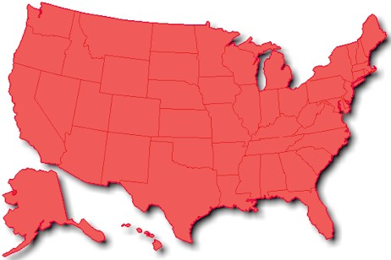
The Past
Package Delivery
Internet Search
Mail Delivery
FAILED

Slide 4


The Past
Package Delivery
Internet Search
Mail Delivery

Slide 5
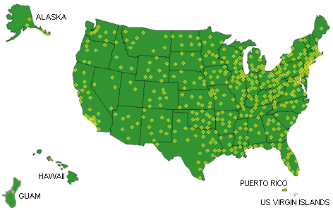
The Past
Package Delivery
Internet Search
Mail Delivery
Salvagible?

Slide 6
Key Idea
Operations Research
Business Analytics!

Slide 7
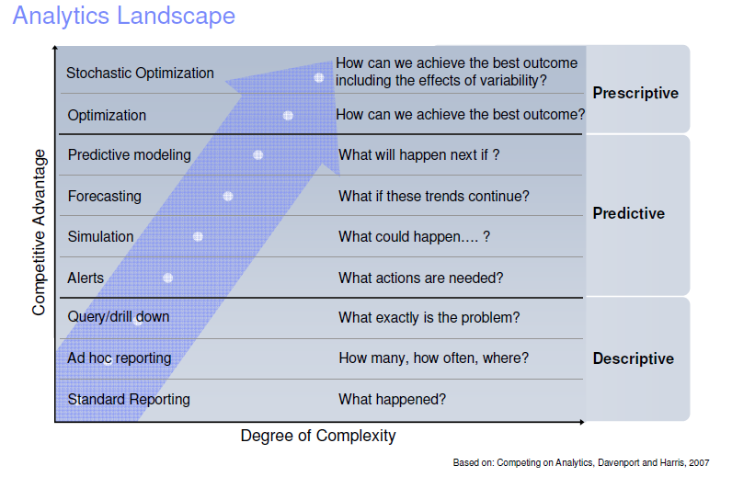
Operations Research

Slide 8
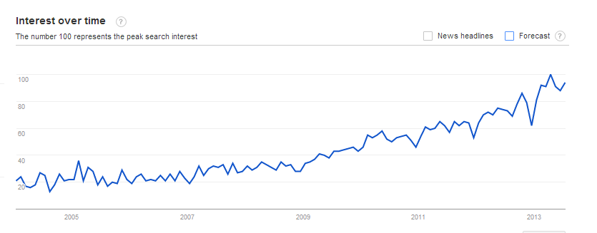
Business Analytics is a Hot Topic
“Business analytics”

Slide 9
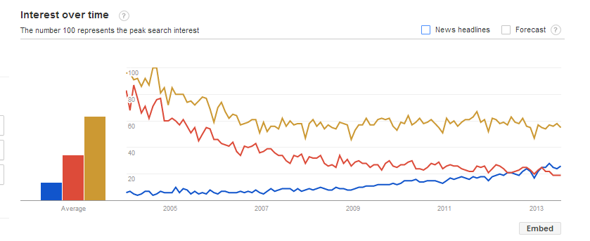
…. Maybe
Management science
Operations research
Business
analytics

Slide 10
Business Analytics
Using data to make better decisions
(what the best operations research has always been)
Change in emphasis: more about data

Slide 11

The Past
Package Delivery
Internet Search
Mail Delivery

Slide 12
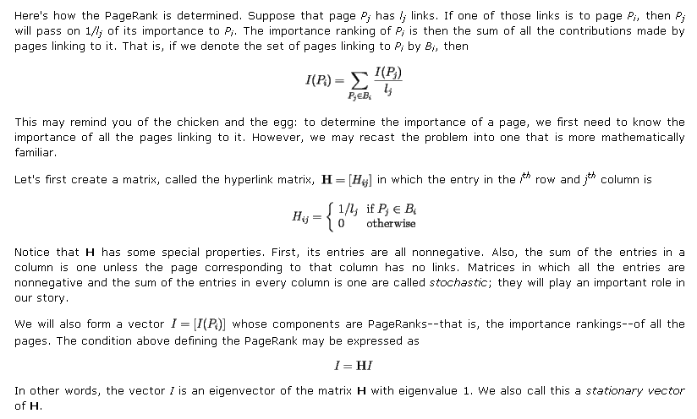
The Past
Package Delivery
Internet Search
Mail Delivery
Google: Treat web pages as data; treat search as optimization

Slide 13
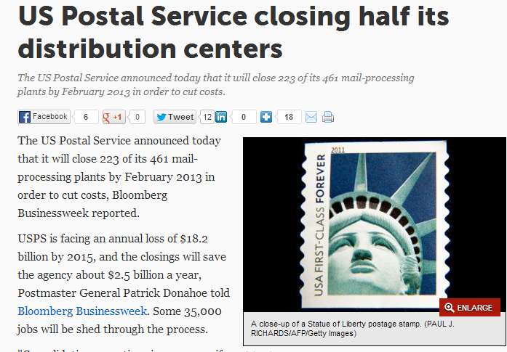
The Past
Package Delivery
Internet Search
Mail Delivery

Slide 14
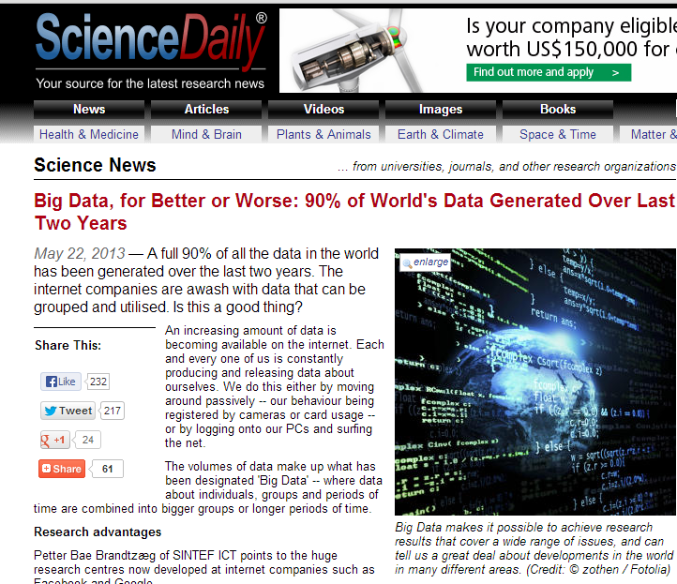
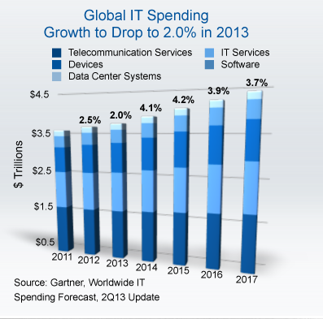
The Present
Data
Computer Speed
Algorithms

Slide 15
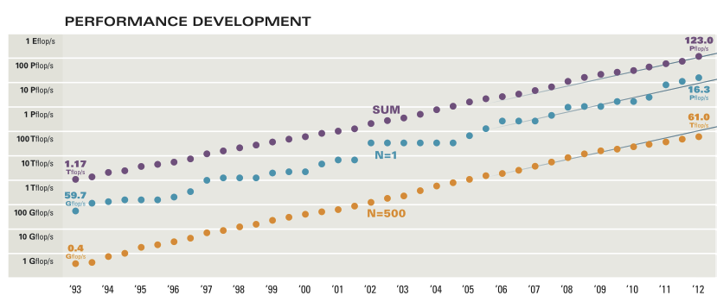
The Present
Data
Computer Speed
Algorithms
2013: $587
From BestBuy

Slide 16
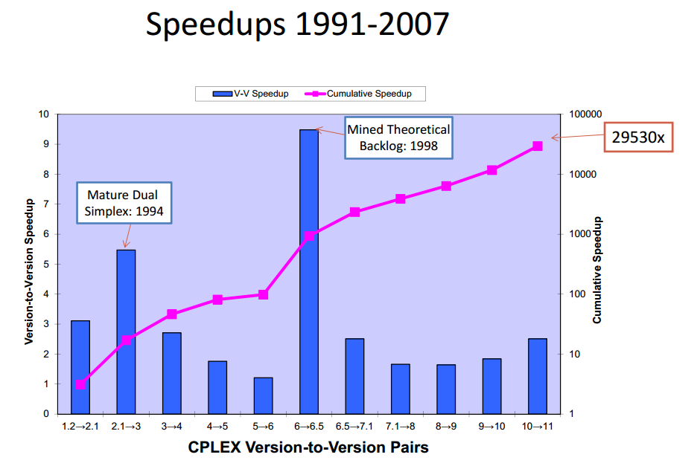
The Present
Data
Computer Speed
Algorithms
Total speedup of OR Methods in 15 years: 1 billion times

Slide 17
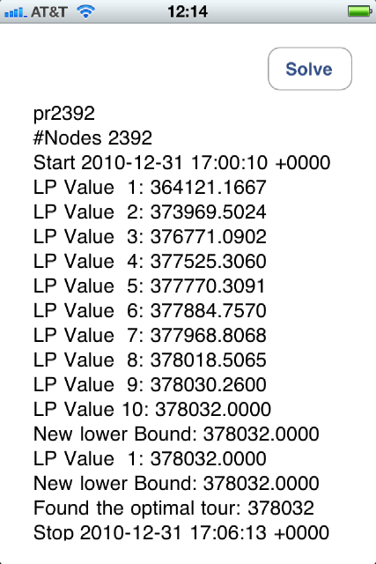
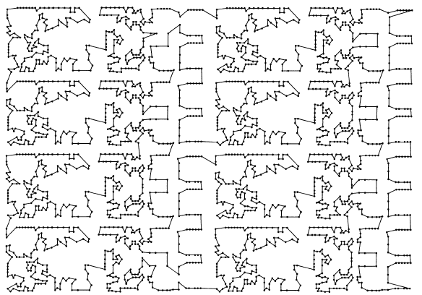
Illustration: TSP with 2392 nodes
2011: Bill Cook and Concorde
with iPhone
1987: Padberg and Rinaldi

Slide 18
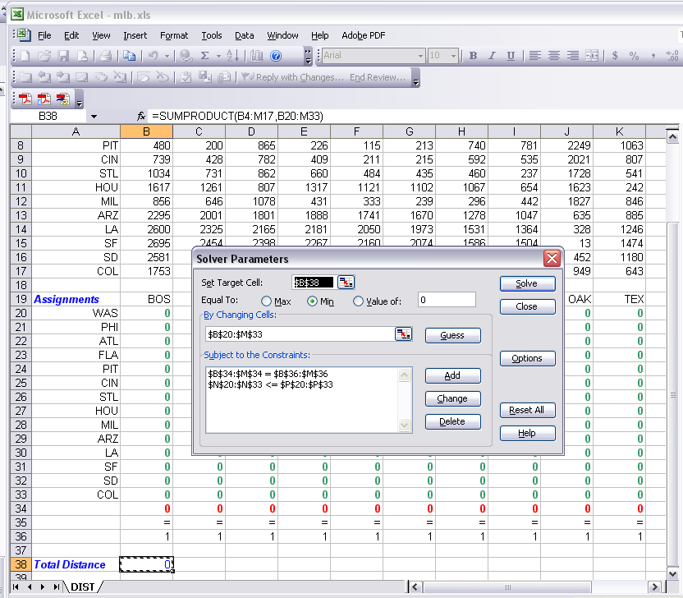

Slide 19
Future: The OR Process
Identify a
Problem
Formulate a Model
Determine
Decisions
Objectives
Constraints
Get Data
Estimate Missing Data
Implement
Solution
Validate Solution
Is it reasonable?
Sensitivity
Find Solution to Model
using Mathematical Tools

Slide 20
The Business Analytics Process
Identify a
Problem
Formulate a Model
Determine
Decisions
Objectives
Constraints
Get Data
Estimate Missing Data
Implement
Solution
Validate Solution
Is it reasonable?
Sensitivity
Find Solution to Model
using Mathematical Tools
Get Data
Estimate Missing Data

Slide 21
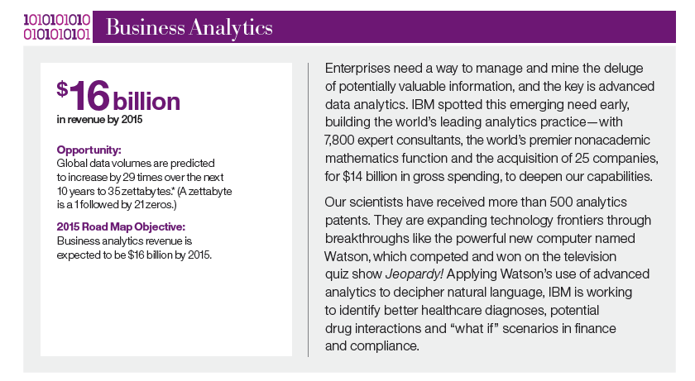
Future is bright!
IBM 2010 Annual report; contrast “cloud” at $7 b and smarter planet $10 b

Slide 22
The Future
Linking Predictive and Prescriptive
Handling Uncertainty
Parallelism
Adversaries

Slide 23
The Future
OR World View
BA World View
Linking Predictive and Prescriptive
Handling Uncertainty
Parallelism
Adversaries

Slide 24
The Future
Linking Predictive and Prescriptive
Handling Uncertainty
Parallelism
Adversaries
How is data helping the organization make better decisions?

Slide 25
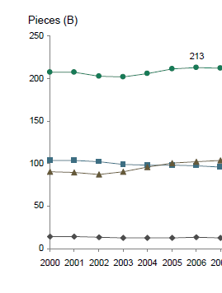
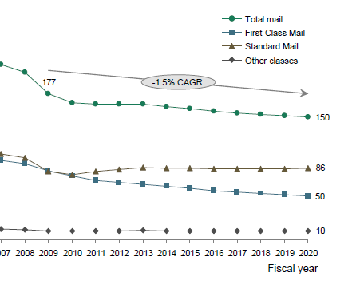
The Future
Linking Predictive and Prescriptive
Handling Uncertainty
Parallelism
Adversaries

Slide 26
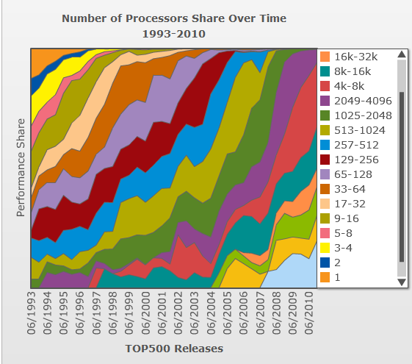
The Future
Linking Predictive and Prescriptive
Handling Uncertainty
Parallelism
Adversaries

Slide 27
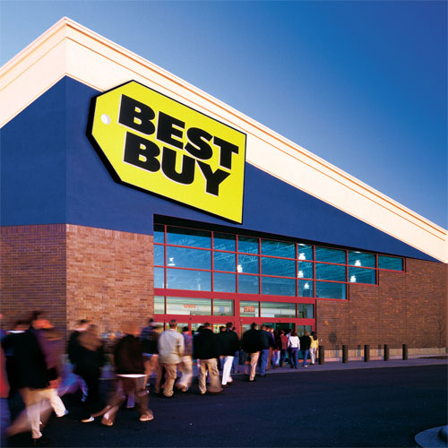
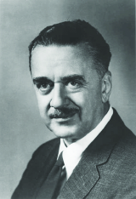
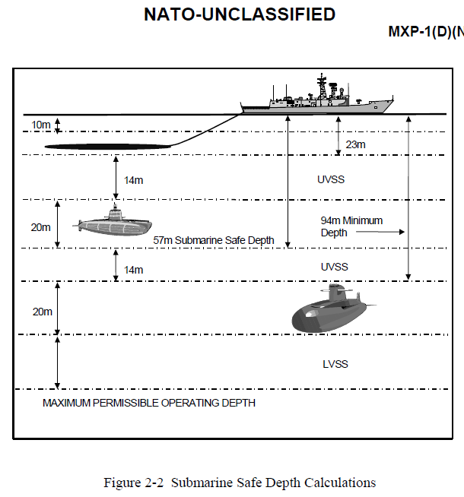
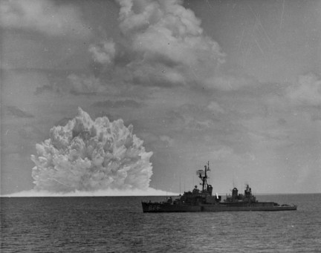
The Future
Linking Predictive and Prescriptive
Handling Uncertainty
Parallelism
Adversaries

Slide 28
Summarize: Business Analytics and…
OR Past
  Fedex
  Google
  USPS
  All examples of key role of data
OR Present
  More Data
  Faster computers
  Better algorithms
  Lower fixed Costs
OR Future
  Predictive Analytics
  Robustness
  Parallelism
  Adversaries
  More at
  http://mat.tepper.cmu.edu/blog

